Slide 1
BLUE DOOR CAFE
The world of EXOTIC Cuisines

Slide 2
PROJECT SUBMITTED BY :-
PIYUSH SHARMA 201500470
NISHANT KUMAR 201500444
AJAY PATEL 201500048
SHIVTOSH DWIVEDI 201500668
B.Tech CSE IIIrd Year Students
GLA UNIVERSITY

Slide 3
ACKNOWLEDGEMENT
A successful work is always raised by many hands.
We are thankful to :
Md. Farmanul Haque Sir (Tech Trainer, CSE Dept.)
All faculties and our friends
CSE Department

Slide 4
WHY THIS IDEA ?
Enables ease for the customers
Overcomes the disadvantages of traditional queueing system
Order food online , eliminating any sort of hassle

Slide 5
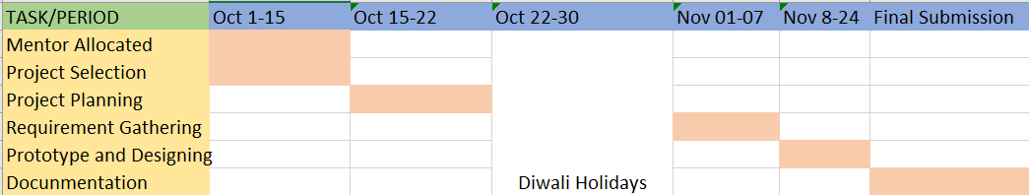
HOW WE PROCEED ?

Slide 6
TECHNOLOGIES USED :-
HTML -
The Hypertext markup language or HTML is a standup markup language for documents designed to be displayed in a web browser.
CSS -
Cascading Style Sheets is a style sheet language used for describing the presentation of a document written in a markup language such as HTML or XML.
JavaScript
Often abbreviated as JS, is a programming language that is one of the core technologies of the world wide web, alongside HTML and CSS.

Slide 7
LETS SEE WHAT WE HAVE IN THE PROJECT

Slide 8
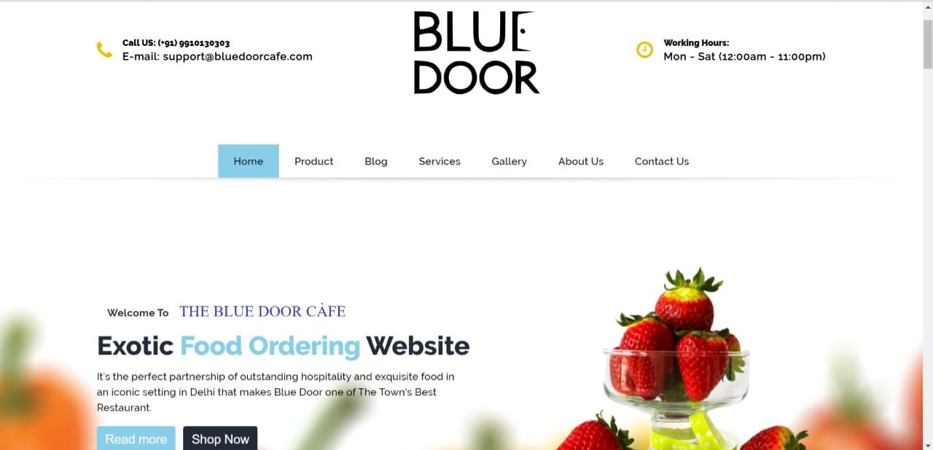
HOME
Homepage of Bluedoor website with navigation menu and contact details.

Slide 9
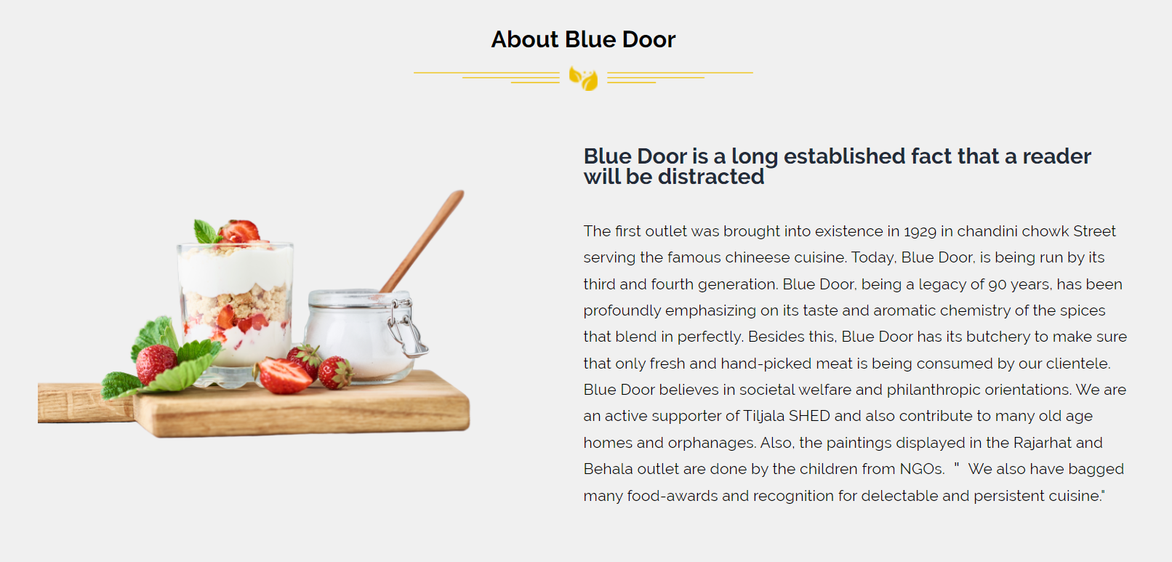
ABOUT BLUEDOOR
A quick description about Bluedoor café and its history.

Slide 10
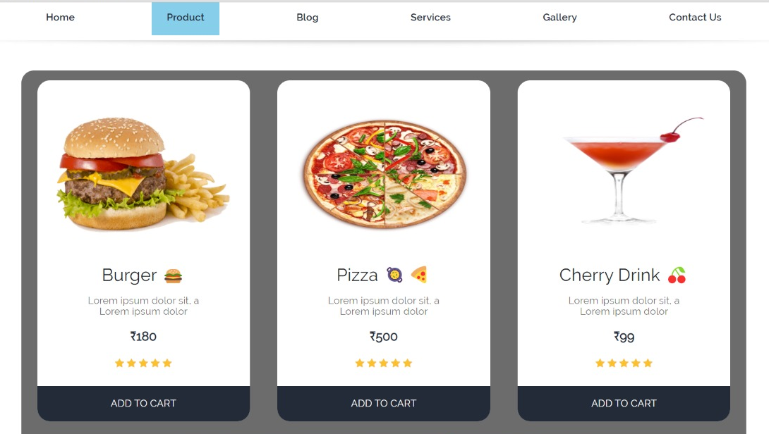
PRODUCTS
Top selling dishes along with the feature to add them into your shopping cart.

Slide 11
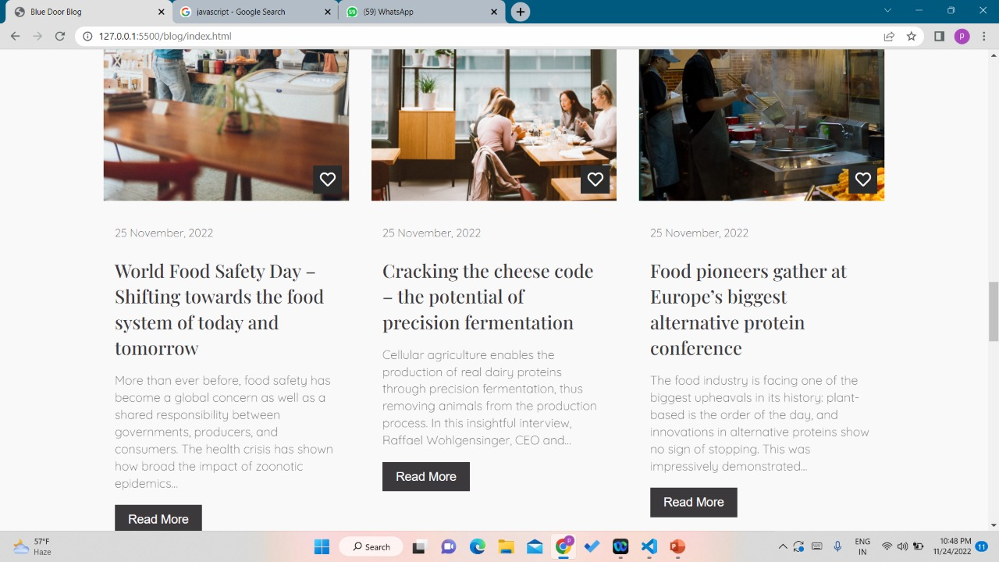
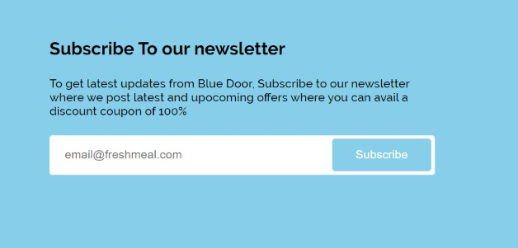
BLOGS & REVIEWS
A very interactive feature for our visitors to write blogs directly onto our website. Also key feature for subscription is available.

Slide 12
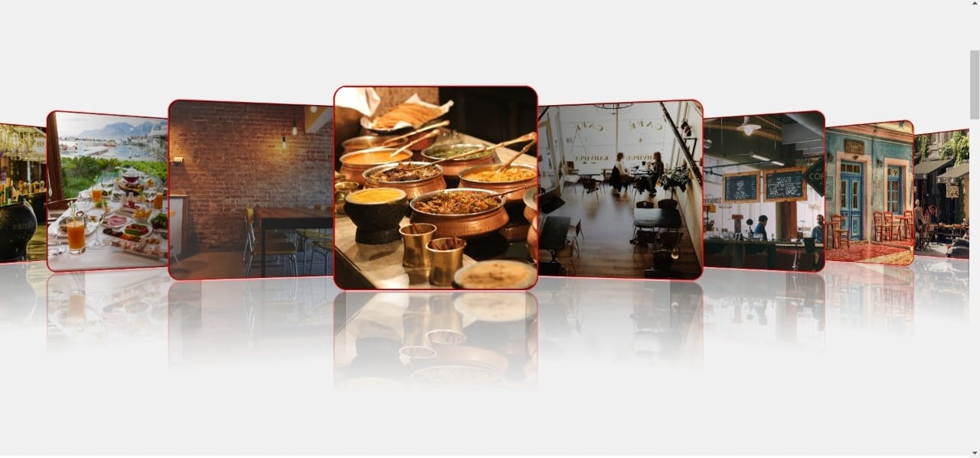
GALLERY
Restaurant that spreads positive and ecstatic vibes.

Slide 13
FUTURE WORK
We welcome suggestions for the project !!
Associate payment gateway links.
Create login credentials for customers.
Realtime order tracking system

Slide 14
THANK YOU !!

